Slide 1
Lesson objective
Need whiteboard markers
Title: Product of primes
Aim:
Represent numbers as a product of it’s primes
Calculate dimensions of squares
Plan:
Daily review
  Substitution
Prime factor form
Area of squares

Slide 2
Prime factor form
Representing numbers as a product of it’s primes
Product
Means multiplication
Prime
- A number that’s only divisible by 1 and itself

Slide 3
Express 36 as a product of primes:
36
2
18
2
9
3
3
2 x 2 x 3 x 3 = 36
2² x 3² = 36

Slide 4
Express 24 as a product of primes:
24
2
12
2
6
2
3
2 x 2 x 2 x 3 = 24
2³ x 3 = 24

Slide 5
Prime factors – I do
48
100
75

Slide 6
Prime factors – we do
32
200
44

Slide 7
Prime factors – you do (whiteboards)
70
45
28
400
48

Slide 8
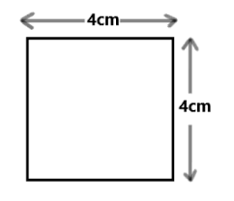
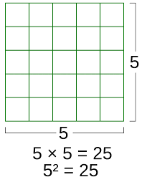
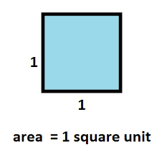
Area of squares

Slide 9
Area of squares
I do / we do / you do
7cm
10m
3mm

Slide 10



Area of squares
What are the dimensions?
$$81{cm}^{2}$$
$${25cm}^{2}$$
$${49m}^{2}$$

Slide 11

Worded questions
James has 5 squares that all have the same area. If the TOTAL area of these 5 squares was $180m^{2}$ what are the dimensions of the squares?

Slide 12
Prime factor practice
Page 105
Questions 4 – 8
Then
Page 207
Questions 6 – 9

